Slide 1

Cancer Care App – Code to Cure 1.0
Final Presentation
Fall 2017
Team Members: Alvaro Villa, Kyle Roque
Product Owner: Annette King
Instructor: Masoud Sadjadi

Slide 2
Project Definition
Problem: No one is ever prepared for a cancer diagnosis. Many patients find it difficult to manage themselves after leaving the hospital or doctor’s office. Having a support group is imperative and no more important than having important information tailored to a patient’s diagnosis. SHAIHN (Smart HealthCare Healing Network), our cancer care app, provides a solution that can positively impact a patient’s overall experience during their times of difficulty.
Solution: SHAIHN allows patients, their caregivers, and health care providers to communicate and share resources, all to enhance the level of care the patient receives. This is done in a system that consists of a community where patients and caregivers can interact with each other and healthcare providers can supply patients with resources containing valuable information related to the patient’s diagnosis.

Slide 3
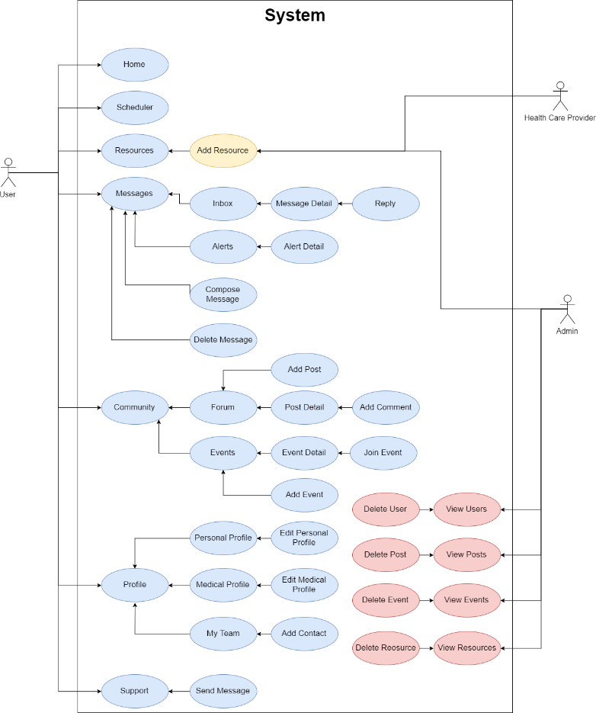
Requirements: Use Cases

Slide 4
System Design: Architecture
Architectural Patterns: The architecture is based on the MEAN stack MVC (Model View Controller) architecture. Like MVC, the system has views and controllers. However, rather than having models, a services layer is used for data access and business logic. Mongoskin is used for the services as a wrapper for the native MongoDB driver, making it simpler to perform CRUD (Create Read Update Delete) operations. This pattern also helps keep angular controllers thin and maintain a clean separation of concerns.

Slide 5
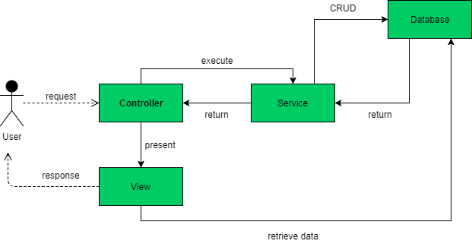
System Design: Architecture

Slide 6
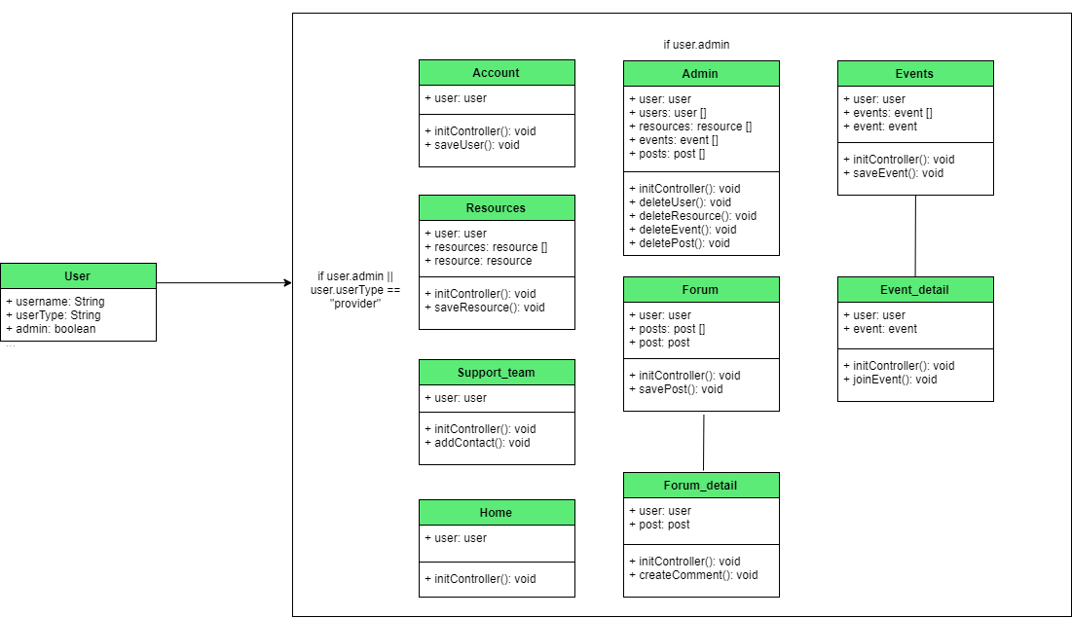
Minimal Class Diagram

Slide 7
User Stories (Refer to documentation for full list)
Account Login
Account Creation
Edit Personal profile (Patient)
Navigation Homepage
Scheduler
Add Resource

Slide 8
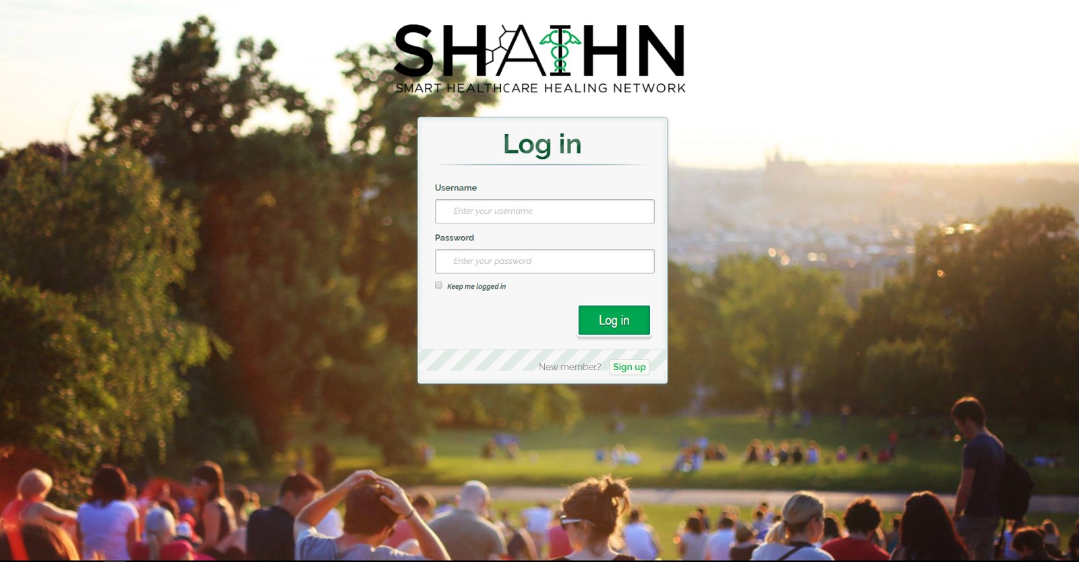
User Story Name: Account Login
Description: As a user, I would like to login to my account so that I can access the resources offered by Cancer Care
Acceptance Criteria
Only users with accounts may access the resources within the Cancer Care app
Email/username and password will be used to sign in.
If a user tries to log in with an invalid email/username, they will receive an error message saying so
If a user tries to log in with an invalid password, they will receive an error message saying so.

Slide 9
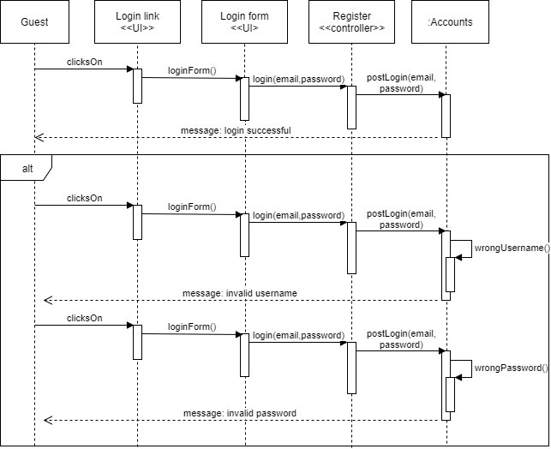
User Story Name: Account Login (Continue)

Slide 10
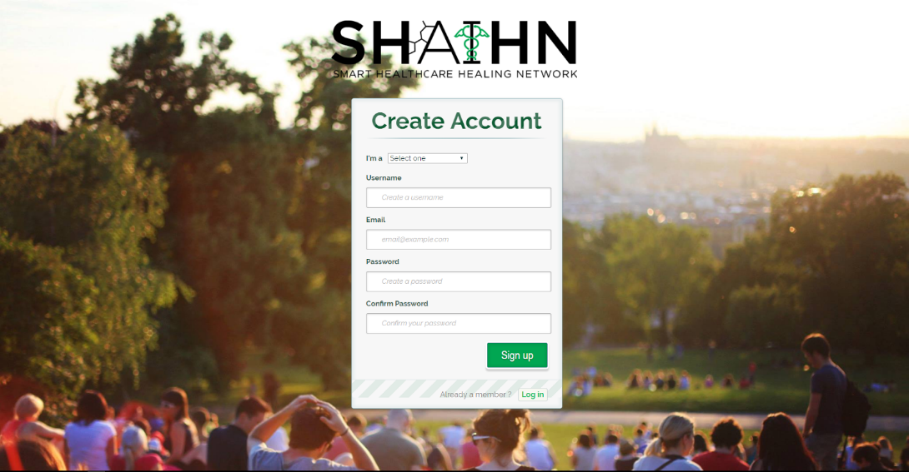
User Story Name: Account Creation
Description: As a user, I want to create an account to participate in forums and interact with people.
Acceptance Criteria
There is a create account page.
Fields required to create account: Username, Email, Password, Account type (patient, caregiver, health care provider), and form submit button “Create Account”.
I am taken to the homepage signed in, after my account has been created

Slide 11
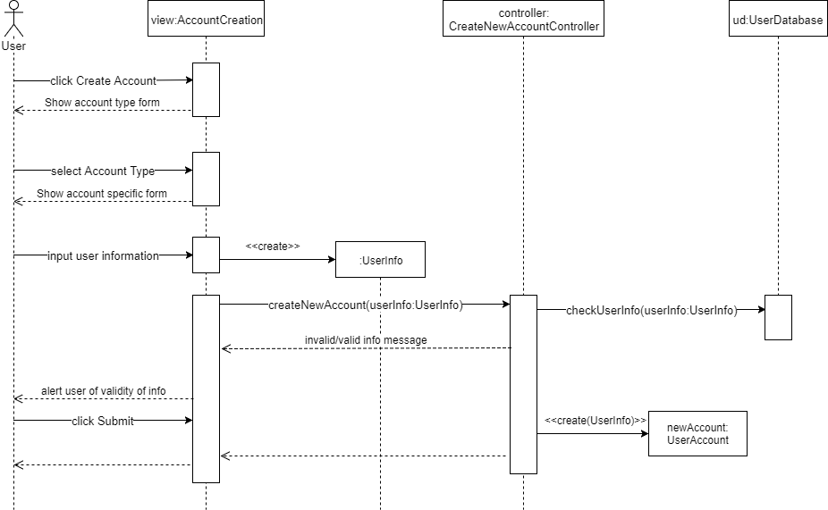
User Story Name: Account Creation (Continue)

Slide 12
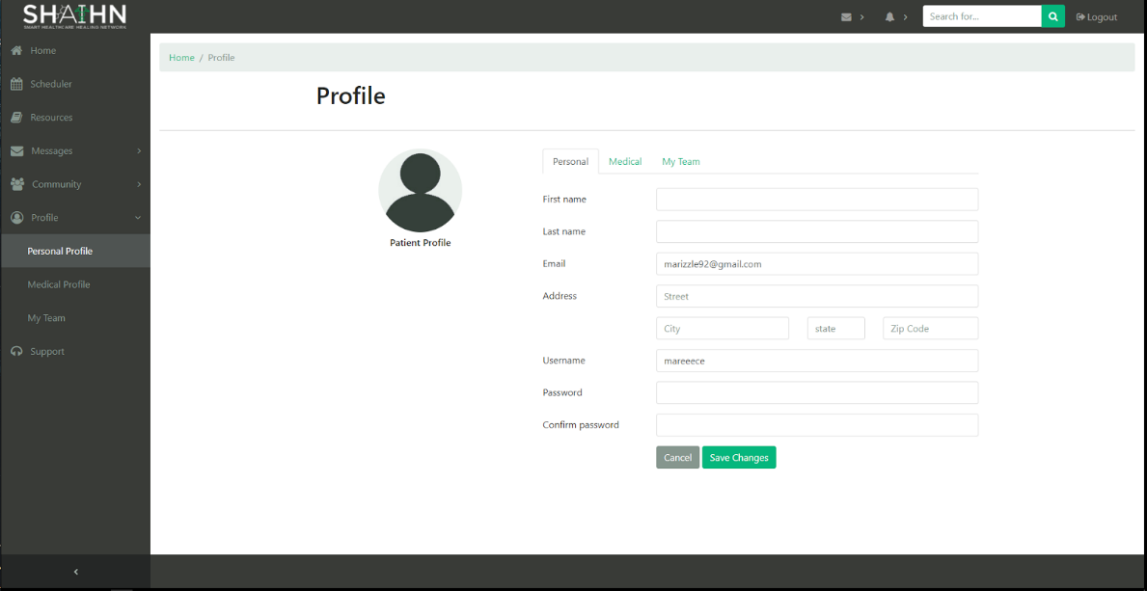
User Story Name: Edit Personal profile
Description: As a user, I want to edit my personal profile, so that I can keep my personal information updated.
Acceptance Criteria
There is a Profile page with a section to include my personal info.
A form to store my basic info contains fields: email, password, username, first name, last name, and address. The form contains Save, and Cancel buttons.
If I update or cancel the form, I am notified.

Slide 13
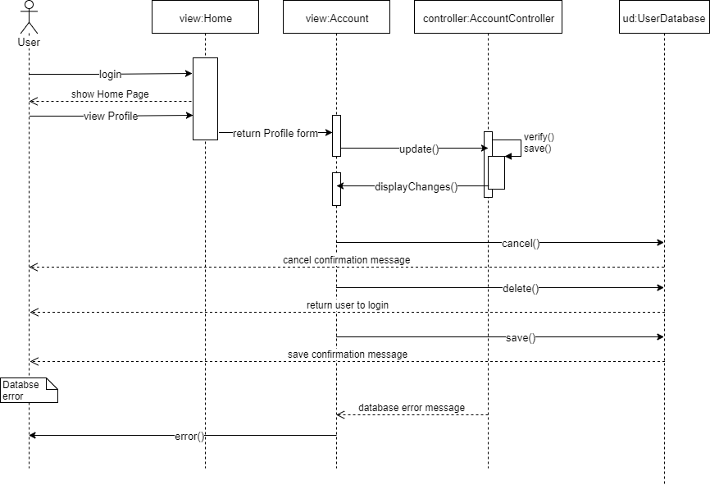
User Story Name: Edit Personal profile (Continue)

Slide 14
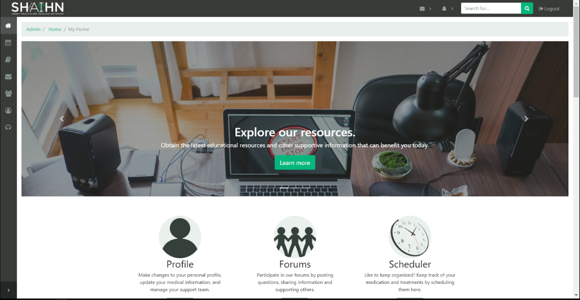
User Story Name: Navigation Homepage
Description: As a user I want to easily browse and navigate to a page utilizing menus centralized on a single homepage to simplify user experience.
Acceptance Criteria
The user is logged in.
The homepage contains tabs that lead to features of the site. Features: view profile, messages, community, medicine scheduler, resources, support, etc.

Slide 15
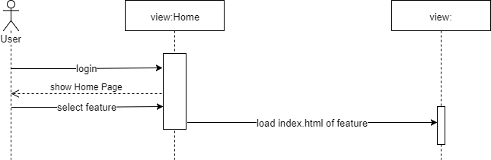
User Story Name: Navigation Homepage (Continue)

Slide 16
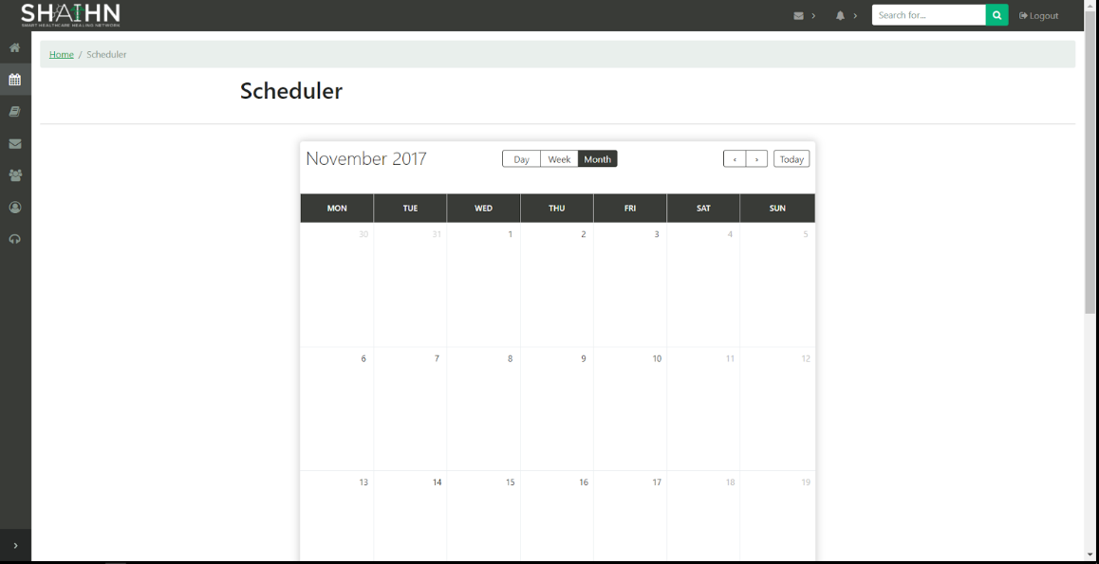
User Story Name: Scheduler
Description: As a cancer patient, I want to schedule appointments or medication to keep organized
Acceptance Criteria
User is signed in.
The scheduler has a calendar.
User can input events on a designated time via calendar.

Slide 17
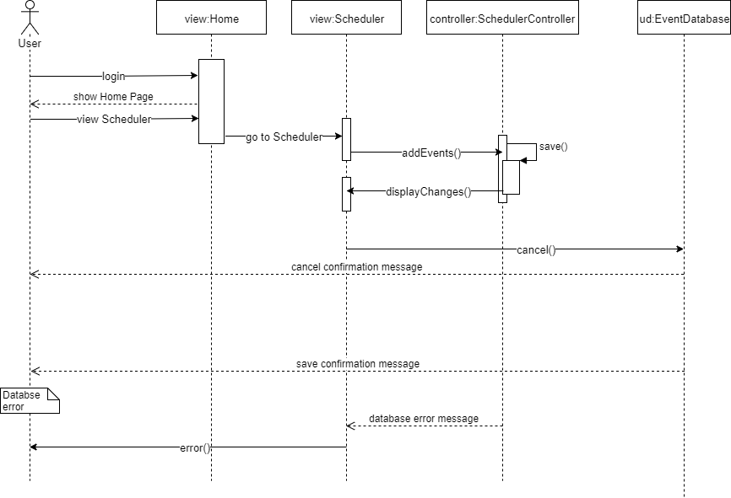
User Story Name: Scheduler (Continue)

Slide 18
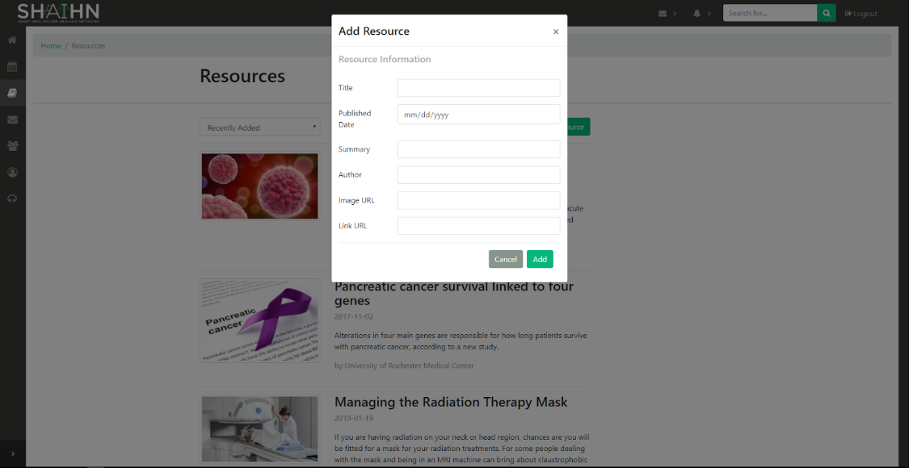
User Story Name: Add Resource
Description: As a health care provider, I want to add resources that I feel are important for cancer patients, so that they can be better informed about their diagnosis.
Acceptance Criteria
Only health care providers can add resources.
Fields for ‘Add Resource’ form consists of ‘Title’, ‘Published Date’, ‘Summary’, ‘Author’, ‘Image URL’, and ‘Link URL’.
After selecting ‘Add’, Resource page is updated.
I can cancel the process anytime.

Slide 19
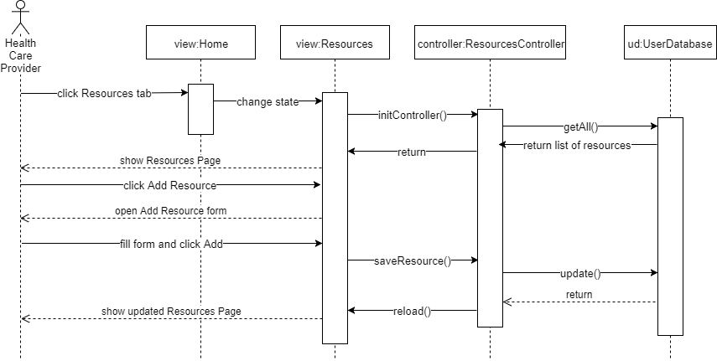
User Story Name: Add Resource (Continue)

Slide 20
Testing
Manual testing was performed for each user story after completion.
In the course of the development of each user story, testing was done in parts, and if that layer passed the testing process, another layer was developed and tested first individually, and then in addition to the previous layer.
In order to gain an idea of how user-friendly and intuitive the app was, usability tests were also performed by having others use the application.
Finally, during each bi-weekly meeting, the app was demoed so that the owner can validate the program herself.

Slide 21







Summary
The app serves as a community resource dashboard for cancer patients, caregivers, and healthcare providers, as well as a means for users to connect with each other and provide support. The technologies used include those of the fullstack javascript framework MEAN, that stands for MongoDB (no SQL database), Express (web application framework), AngularJS (front-end framework), and NodeJs (server-side platform). Bootstrap among other technologies was used for front-end design.
Alvaro Villa (avill169@fiu.edu)
Kyle Roque (kroqu001@fiu.edu)
Question?
Thank You

